Slide 1
Chapter 12
Getting Started with Bootstrap

Slide 2
Chapter Objectives
You will have mastered the material in this chapter when you can:
Describe the Bootstrap framework
Create a webpage using Bootstrap’s starter template
Create a Bootstrap navbar
Integrate a Bootstrap hamburger menu
Style navigation links using Bootstrap
Define and create a jumbotron
Explain how to style text using Bootstrap

Slide 3
Chapter Objectives (continued)
Write a jQuery document ready event
Describe and use the Bootstrap grid system
Explain how to style images using Bootstrap
Style a table using Bootstrap
Describe a content management system

Slide 4
Introduction
Many of today’s modern websites use some type of content management system or web framework
Both tools provide a means to create beautiful, responsive webpages more quickly than a standard text editor
Bootstrap is a popular front-end web framework
Used to create responsive webpages

Slide 5
Project — Create a Website Using Bootstrap
Roadmap
Create a Bootstrap webpage
Create a Bootstrap navbar
Create a Bootstrap jumbotron
Create Bootstrap columns
Create a footer
Add Bootstrap classes to the About Us page
Add Boostrap classes to the Classes page

Slide 6
Exploring Bootstrap
Bootstrap is a popular, mobile-first, front-end, responsive design web framework
Used for development
Consists of HTML, CSS, and JavaScript
Provides a standard foundation on which to build a website
Simplifies the coding process by providing access to predefined style sheets and script file

Slide 7
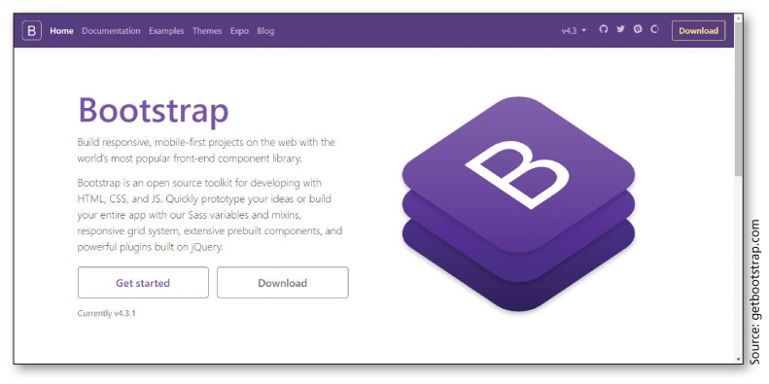
Exploring Bootstrap (continued 1)
Figure 12–4

Slide 8
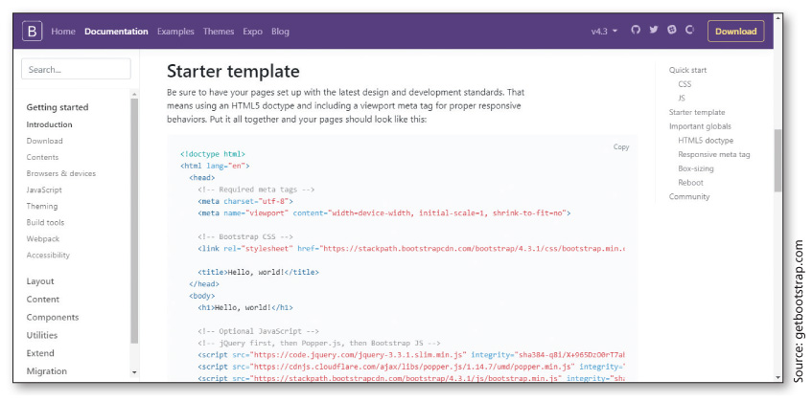
Exploring Bootstrap (continued 2)
Figure 12–6

Slide 9
Bootstrap Navigation Bar
The Bootstrap framework provides several options to integrate a navigation bar
Create a nav element that specifies the navbar
Create a responsive navbar with the navbar-expand class, followed by -sm, -md, -lg, or -xl to set the size of the vertical navbar
You can format the background color and link text color for the navbar using Bootstrap as well
You can also format the navbar to remain at the top of the page, or create a “sticky” navbar

Slide 10
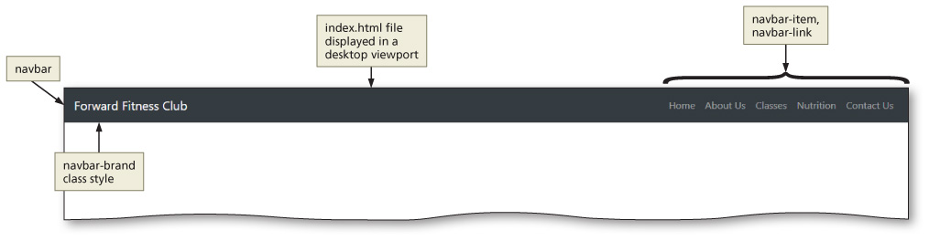
Bootstrap Navigation Bar (continued)
Figure 12–17

Slide 11
Bootstrap Responsive Containers
The Bootstrap framework includes hundreds of predefined style rules for classes
Two important class values
Container class: uses a fixed width, based on the size of the current viewport
Container-fluid class: sets the width to 100%, using the complete width of the viewport
Both classes are used to make an HTML element responsive

Slide 12
Bootstrap Jumbotron
The jumbotron is a large, responsive box used to contain webpage information
Commonly used for hero content near the top of webpage
To create a jumbotron, you use the jumbotron or jumbotron-fluid class
Jumbotron class includes rounded corners
Jumbotron-fluid class does not use rounded corners and spans the full width of the viewport

Slide 13
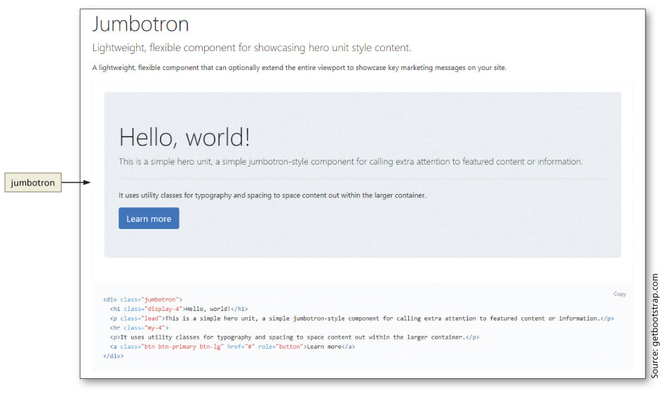
Bootstrap Jumbotron (continued)
Figure 12–19

Slide 14
Margins and Padding
Bootstrap makes it easy to add responsive margins and padding to any element using margin and padding classes
Refer to Table 12-3 for Bootstrap margin and padding classes

Slide 15
Images
Responsive images allow an image to grow and shrink, depending on the size of the viewport
To make an image responsive, you need a style rule for the img element that sets the max-width to 100%; Bootstrap has created this style rule with the img-fluid class, which also sets the height to auto
Apply rounded corners to an image by applying the rounded class to an img element
Align images to the left or right by using the float-right and float-left classes

Slide 16
Bootstrap Colors
Class (Color) | Meaning
primary (blue) | Used to indicate primary, important information
secondary (medium gray) | Used to indicate secondary information
success (green) | Used to indicate success
info (teal) | Used for information
warning (orange/yellow) | Used to indicate a warning
danger (red) | Used to indicate danger
light (light gray) | Styles with light gray
dark (dark gray) | Styles with dark gray
Table 12–4 Bootstrap Colors

Slide 17
Styling Buttons
The Bootstrap framework provides many options to style buttons
Refer to Table 12-5 for a summary of Bootstrap button classes

Slide 18
Custom Styles
Bootstrap framework can significantly reduce the time it takes to create a responsive webpage
Easy to incorporate Bootstrap’s predefined classes where needed
Despite being connected to Bootstrap’s style sheet, you can still create your own custom style sheet and apply it to your website
The key is to list your custom style sheet below the link to the BootstrapCDN

Slide 19
Using jQuery
Popular JavaScript library used by developers to quickly add JavaScript functionality to a webpage
Using jQuery, you can select HTML page elements and use jQuery methods to perform some type of action
Refer to Table 12–6 for a list of some common jQuery methods
When writing jQuery statements, begin each statement with the $ symbol

Slide 20
Using jQuery (continued)
Method | Description | Example
hide() | Hides an element | $(“p”).hide();
show() | Shows an element | $(“div”).show();
fadeIn() | Fades in an element | $(“p”).fadeIn();
fadeOut() | Fades out an element | $(“div”).fadeOut();
slideUp() | Slides an element up | $(“p”).slideUp();
slideDown() | Slides an element down | $(“div”).slideDown();
animate() | Animates an element | $(“p”).animate();
Table 12–6 jQuery Methods

Slide 21
Using the Bootstrap Grid System
Bootstrap uses a grid system that consists of up to 12 columns across a page
To use the grid system, create a row using the row class value, and then specify the number of columns needed for each row
There are five classes that can be used to create rows
Refer to Table 12–7 for a summary of Bootstrap grid classes
Each grid class scales up to the next media query breakpoint, so if you use col-sm-3, it will scale up for the medium, large, and extra-large device breakpoints

Slide 22
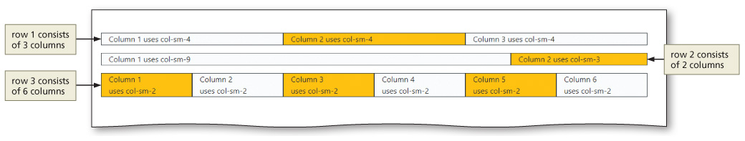
Using the Bootstrap Grid System (continued)
Figure 12–33

Slide 23
Bootstrap Typography Classes
Text can be styled many ways using Bootstrap classes
Refer to Table 12–8 for a list of several Bootstrap style options

Slide 24
Styling Tables with Bootstrap
Bootstrap provides many class value options to style a table
To apply a Bootstrap table, add the table class value to the starting table tag, as follows:
<table class="table">
If you want to style the table to use a dark gray background and white text, apply the table-dark class to the starting table tag
Refer to Table 12–9 for a summary of Bootstrap table classes

Slide 25
Content Management Systems
Online system used to manage website content
Typically consists of a content management application (CMA) and content delivery application (CDA)
CMA provides a webpage author the ability to add, remove, and modify content without knowing HTML
Author can simply make the necessary modifications, and then the CDA compiles the changes and writes the underlying code

Slide 26
Content Management Systems (continued 1)
Content management systems provide web developers the means to create a website design and then “lock it down”
Helpful and important when it comes to novice users updating webpage content
Takes pressure off a webmaster by allowing multiple authors to update pages as necessary
Provides peace of mind to the webmaster, knowing their hard work cannot be undone
Popular content management systems include WordPress, Joomla, and Drupal

Slide 27
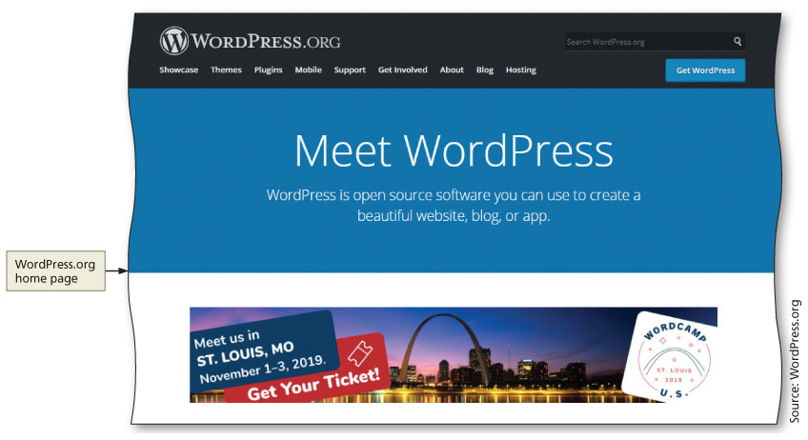
Content Management Systems (continued 2)
Figure 12–61

Slide 28
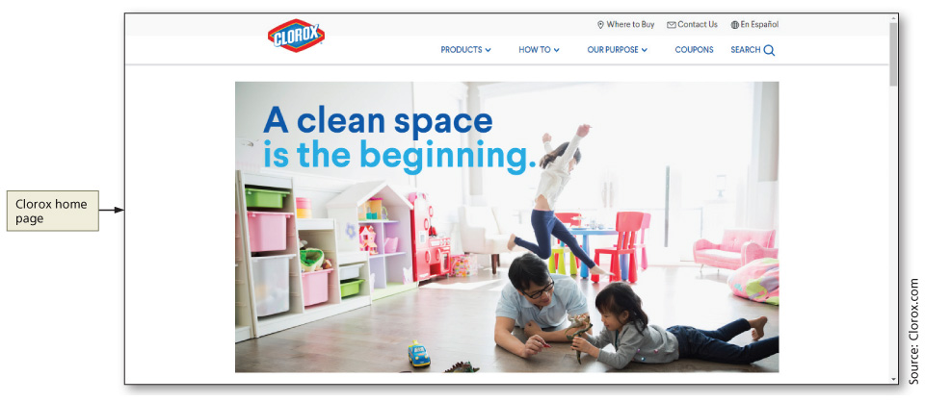
Content Management Systems (continued 3)
Figure 12–62

Slide 29
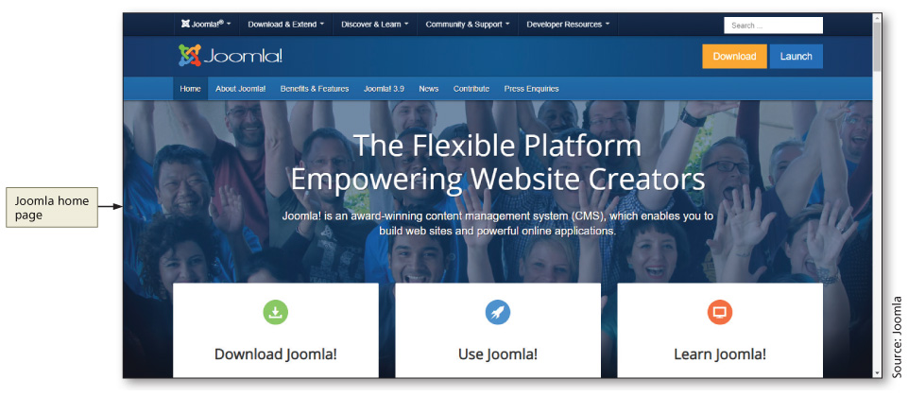
Content Management Systems (continued 4)
Figure 12–63

Slide 30
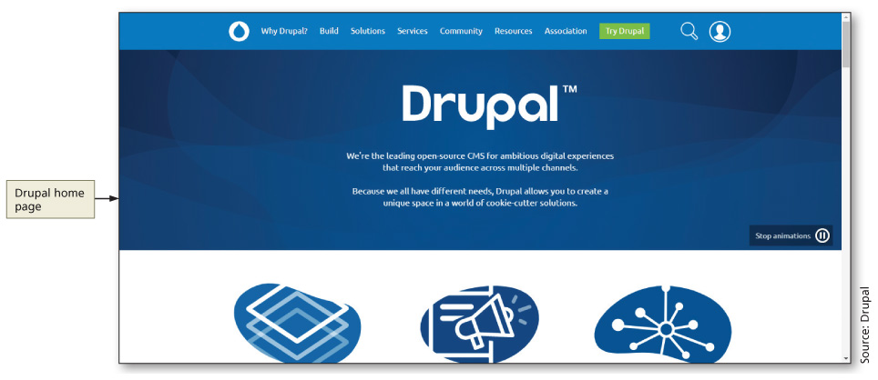
Content Management Systems (continued 5)
Figure 12–64

Slide 31
Chapter Summary
In this chapter, you learned how to:
Create a webpage using the Bootstrap framework
Obtain and use the Bootstrap starter template
Create a Bootstrap navbar
Integrate a Bootstrap hamburger menu
Style navigation elements using Bootstrap
Create a Bootstrap jumbotron
Style text and images using Bootstrap
Write a jQuery document ready event
Use the Bootstrap grid system to layout page content
Style a table using Bootstrap
Use content management systems

